Slide 1
Lecture 7
Topics
  The Real World of IC Logic
    IC Packages
    IC Logic Families
    Key IC Parameters
    CMOS IC Datasheets
    Detailed Schematics using ICs

Slide 2
Taxonomies of ICs

Slide 3
Taxonomies of ICs
Density/Level of Integration
  SSI (Small Scale Integration) ~10 gates/IC
  MSI (Medium Scale Integration) 10² gates/IC
  LSI (Large Scale Integration) 10³ gates/IC
  VLSI (Very Large Scale Integration) 10⁷-10⁸ gates/IC

Slide 4
Taxonomies of ICs
Design Methodology
  Standard Components (SSI/MSI/LSI)
    Off-the-shelf Components
    Basic Universal Building Blocks (AND, OR, NAND, NOR…)
  Application-Specific Standard Parts (ASSP)
    Target Specific Application Area, but not Customer
    e.g. Printer Controller, USB Interface IC, HDD I/F
  Application-Specific IC (ASIC)
    Custom Design of IC Targeting Specific Market
    Full-custom, standard cell, gate-arrays
    e.g. ATI 3D Graphics Engine
  Programmable Logic Devices (PLD)
    Can be used to implement wide variety designs
    e.g. FPGA (Field-Programmable Gate Arrays)

Slide 5
Taxonomies of ICs
Technology
  Bipolar
    TTL (Transistor-Transistor Logic)
    ECL (Emitter Coupled Logic)
    others
  CMOS
Advantages
  Inexpensive
  High level of integration
  High speed
  Very low quiescent (static) power consumption
  “Rail-to-Rail” outputs
Disadvantages
  Susceptible to electrostatic discharge (ESD) damage
  Susceptible to “latch-up”
Has become dominant logic technology

Slide 6
Taxonomies of ICs
Families
  TTL
    STD TTL: Standard TTL
    LS TTL: Low Power Schottky TTL
    AS TTL: Advanced Schottky TTL
    ALS TTL: Advanced Low Power Schottky TTL
    F/FAST TTL: Fairchild Advanced Schottky TTL
  CMOS
    AC: Advanced CMOS
    ACT: Advanced CMOS (TTL Compatible)
    HC: High Speed CMOS
    HCT: High Speed CMOS (TTL Compatible)

Slide 7
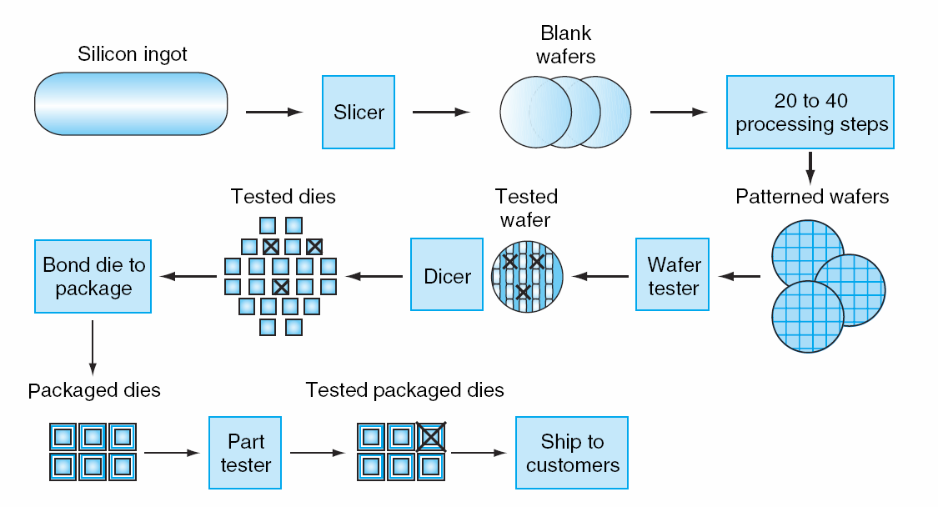
Integrated Circuit Costs
Die

Slide 8
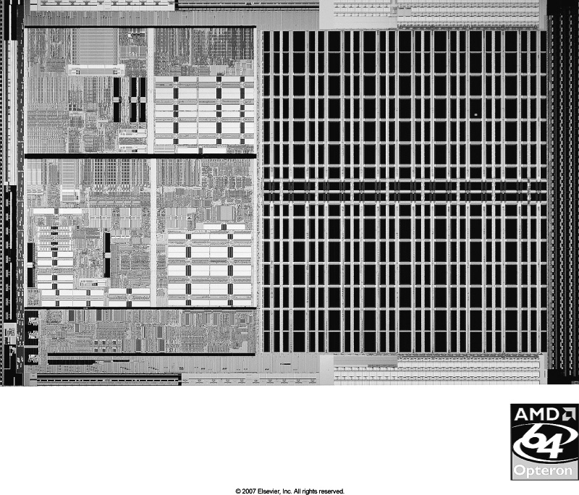
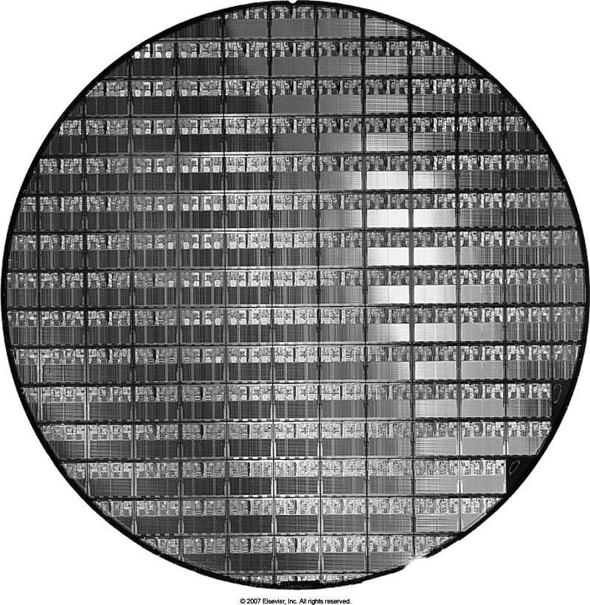
AMD Opteron

Slide 9
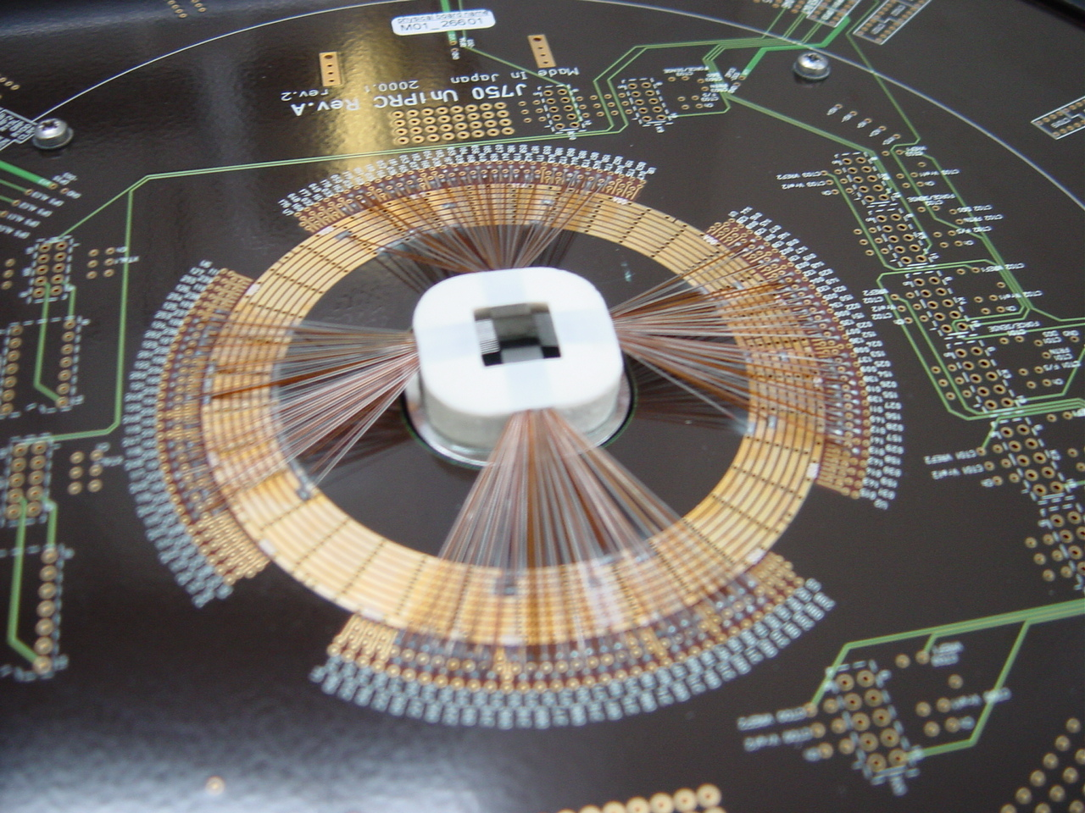
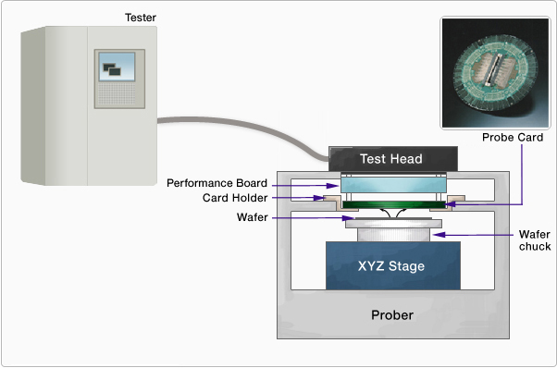
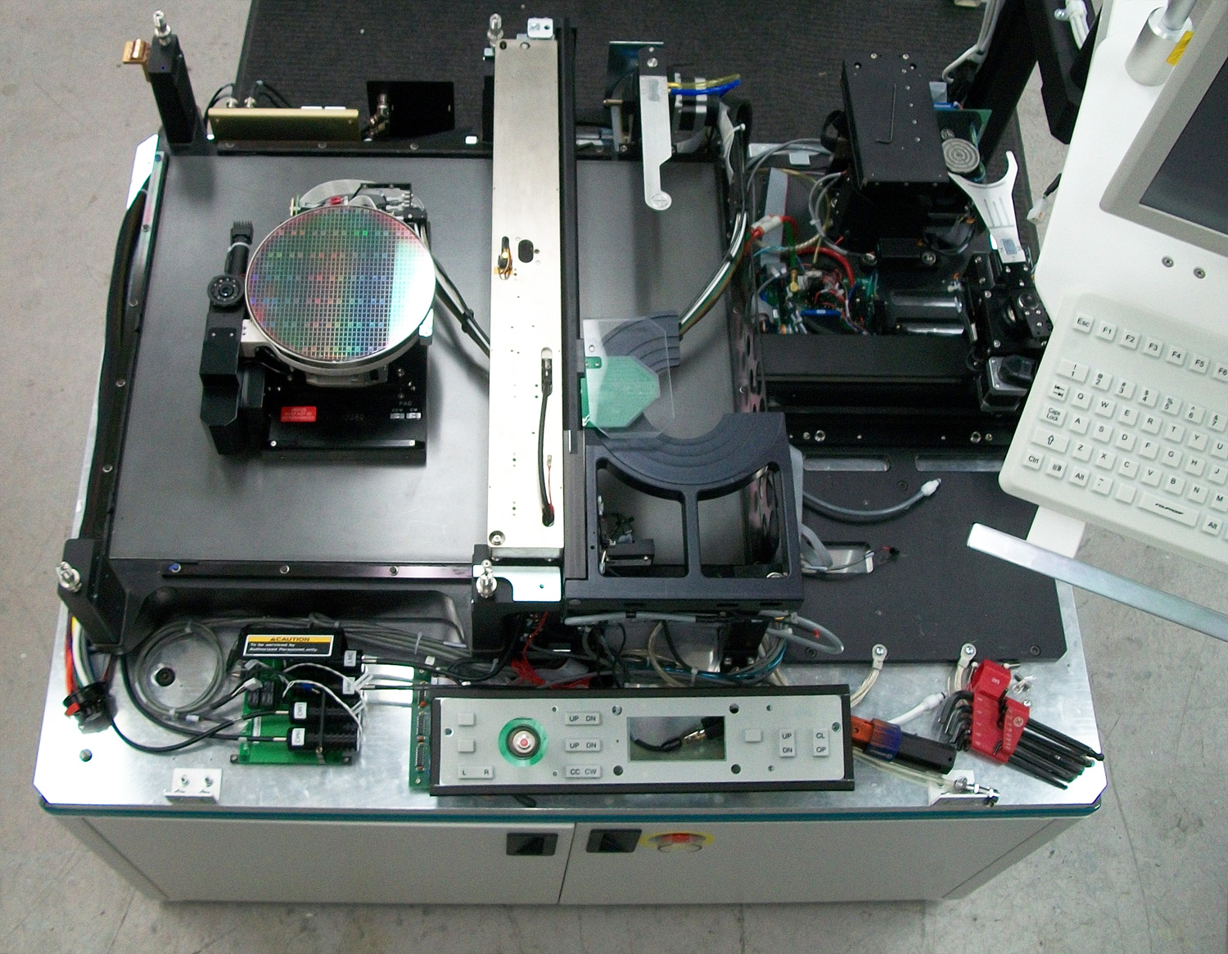
Wafer Probing

Slide 10
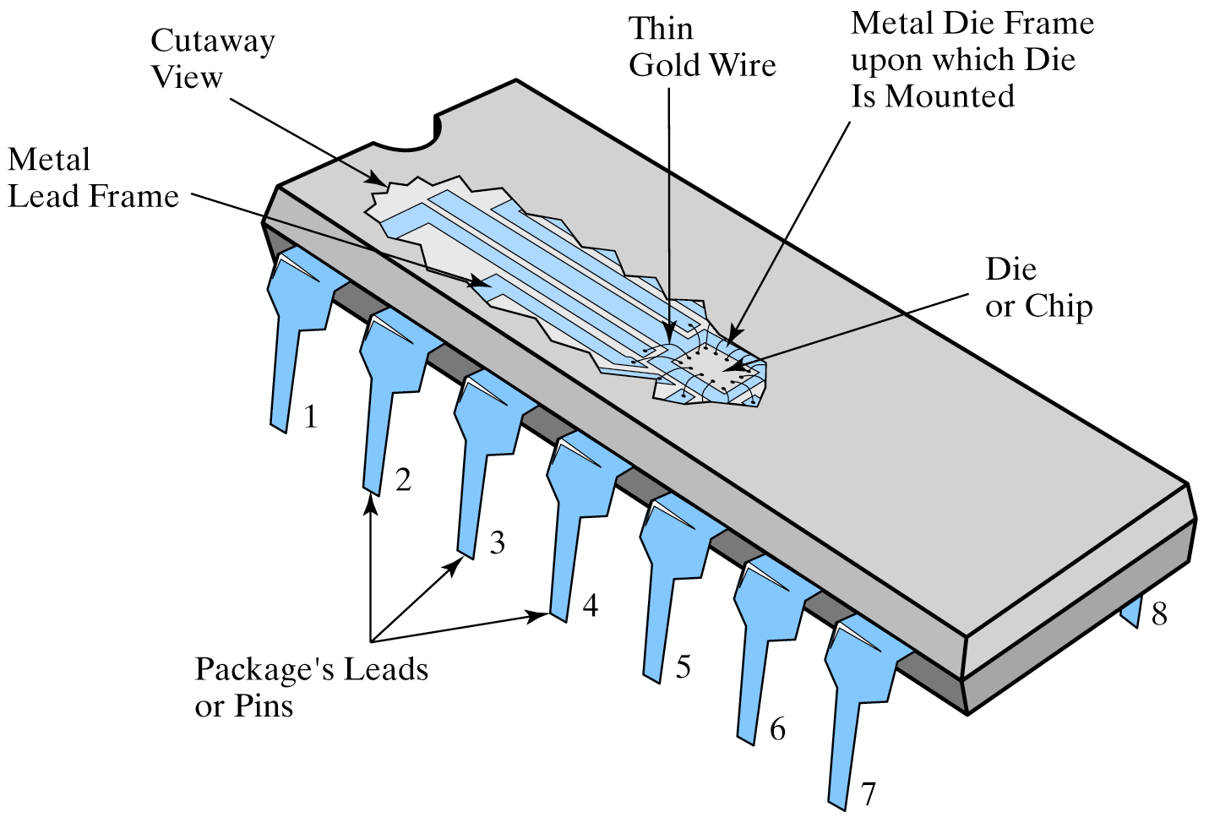
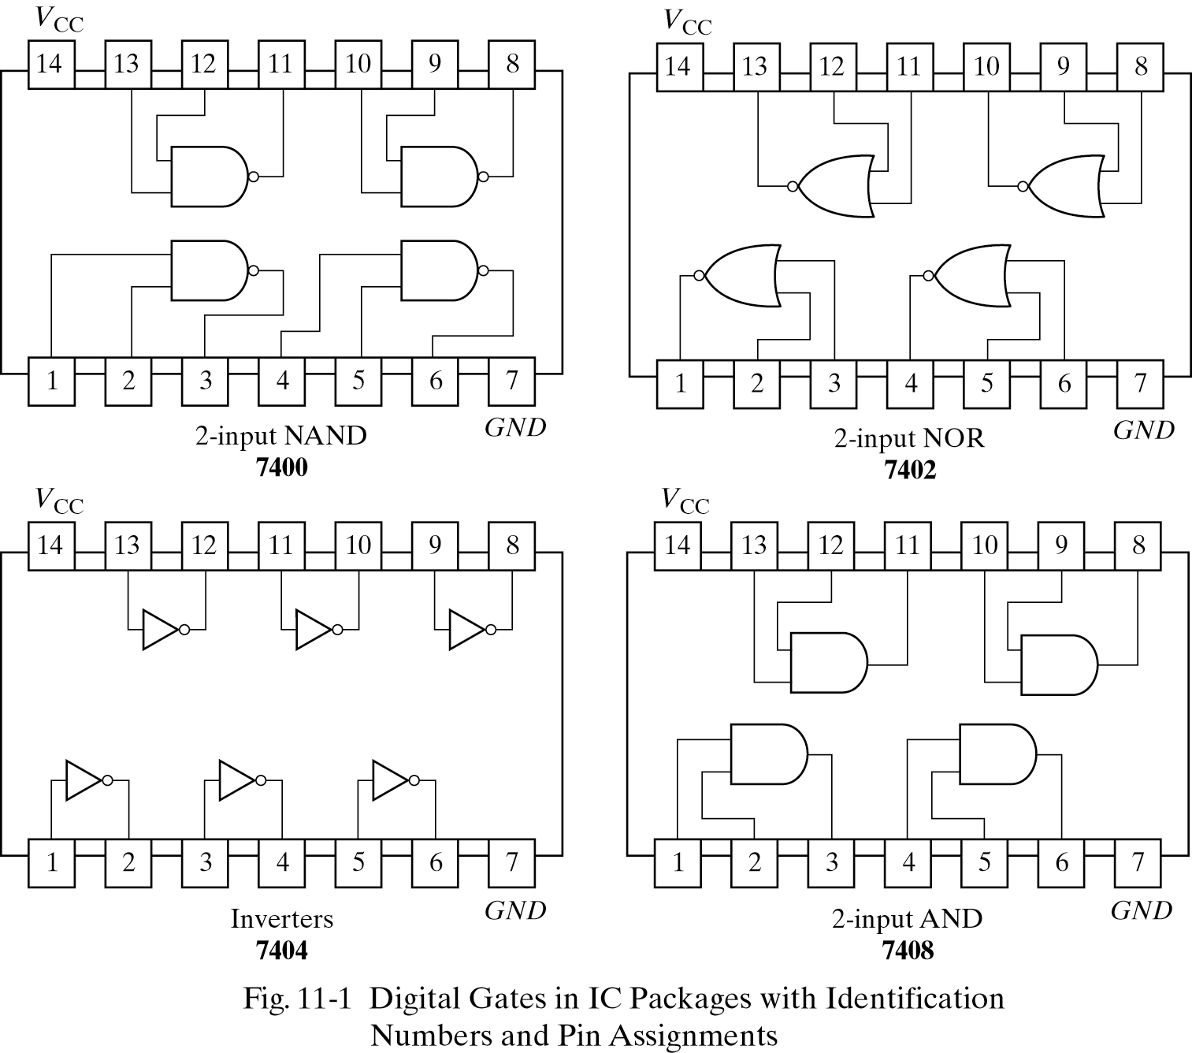
DIP (Dual In-Line Package) Details

Slide 11
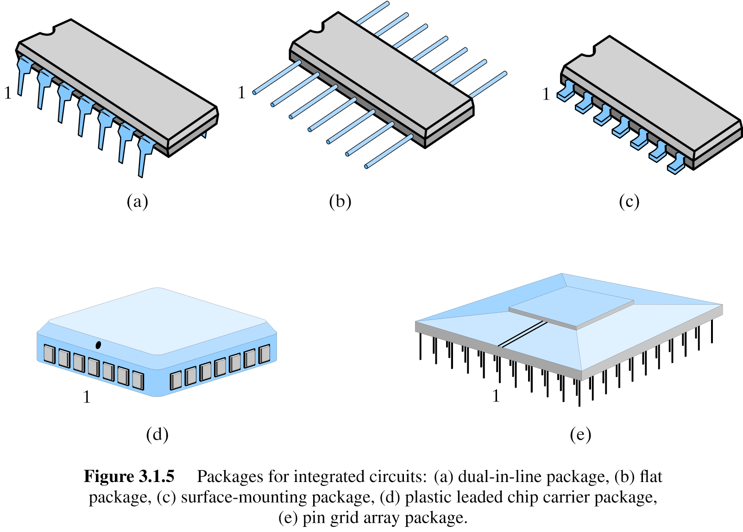
Additional IC Package Types
dual-in-line
flat
surface-mounting
Plastic leaded chip carrier
Pin grid array

Slide 12
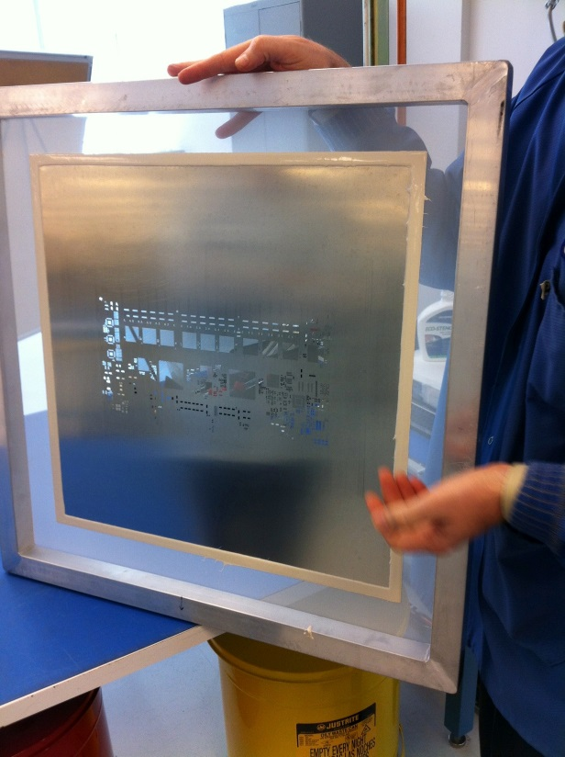
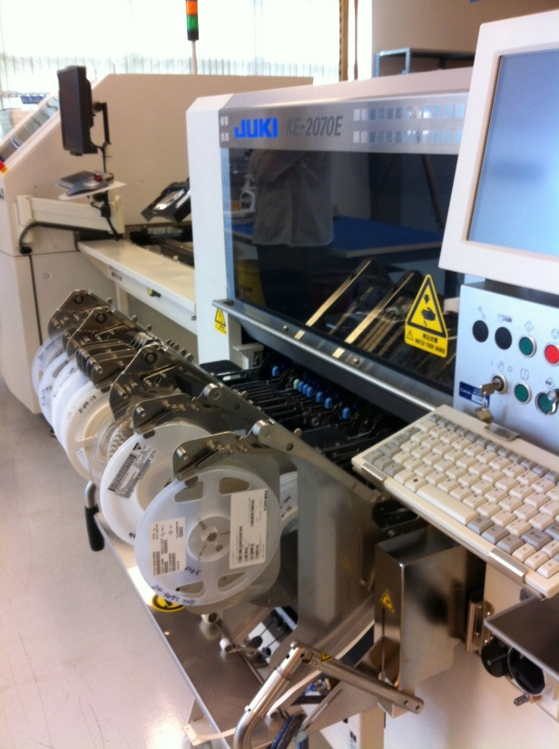
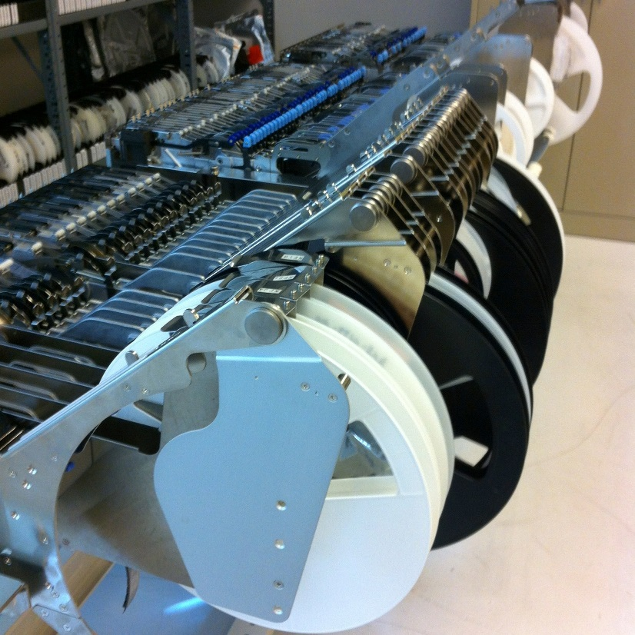
Surface Mount (SMT) PCB Assembly
Solder paste stencil
SMT placement system
Component feeder

Slide 13
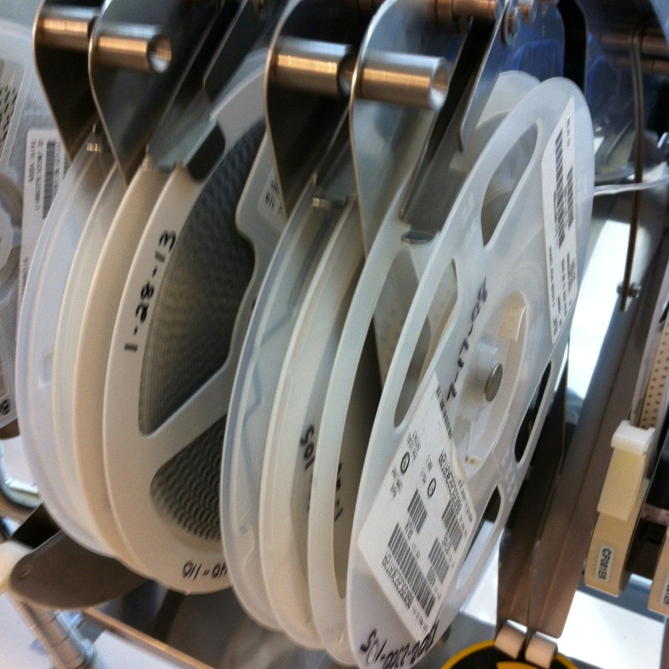
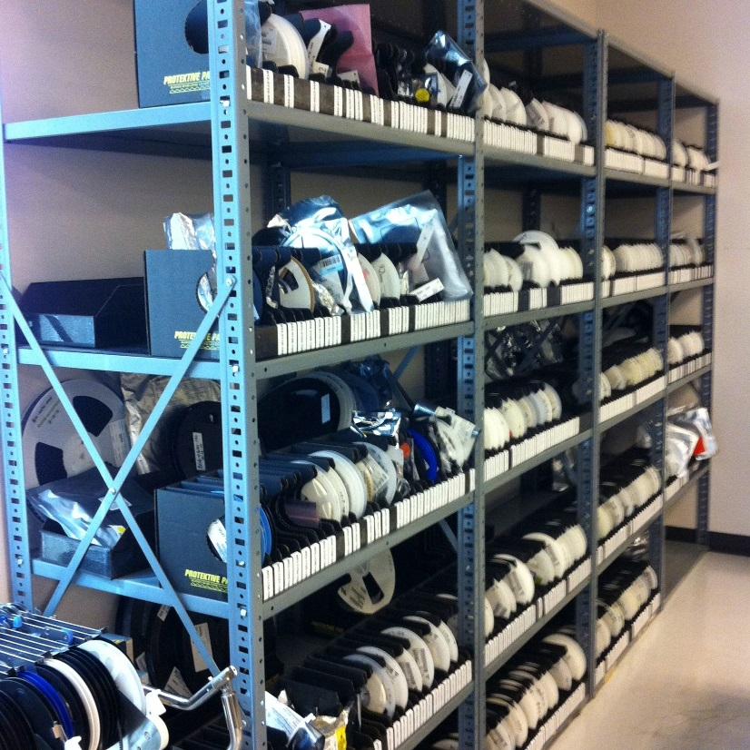
Surface Mount (SMT) Components
SMT components on reel
SMT components in inventory

Slide 14
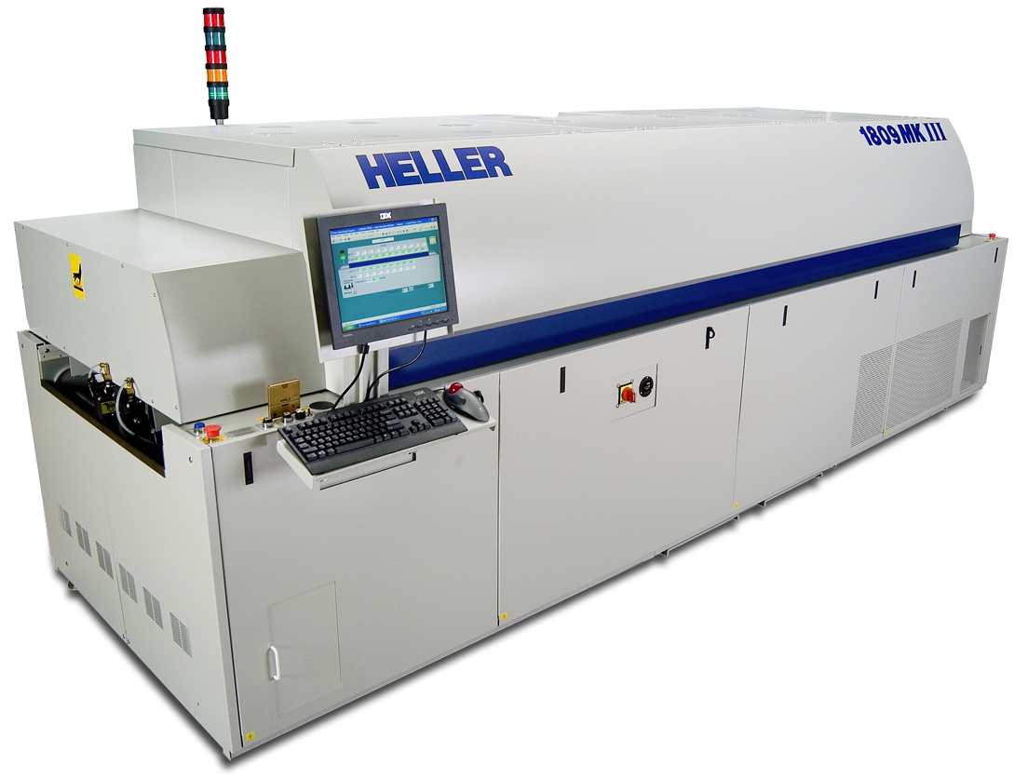
Surface Mount (SMT) Assembly
Reflow oven

Slide 15
Key IC Parameters

Slide 16
Key IC Parameters
Vcc (Power Supply Voltage)
Logic Levels
  V_{IH}, V_{IL}, V_{OH}, V_{OL}
  Noise Margin
Propagation Delay (t_{pd})
Rise/Fall Times (T_{r}, T_{f})
Power Dissipation
Fan-Out

Slide 17
Vcc – Power Supply Voltage
Common across a logic family (e.g. 5V for all HC parts)
Vcc and Gnd commonly called “power supply rails”
  Sometimes Vdd and Vss for CMOS devices
+5V

Slide 18
Logic Levels

Slide 19
Logic Levels
Common across a logic family (e.g. all HC parts)
V_{IH}, V_{IL}, V_{OH}, V_{OL}
  V_{IH} Minimum input voltage guaranteed to be recognized as H
  V_{IL} Maximum input voltage guaranteed to be recognized as L
  V_{OH} Minimum output voltage guaranteed produced for H
  V_{OL} Maximum output voltage guaranteed produced for L
+5V
Typical CMOS Values
  V_{OH} V_{cc} – 0.1V
  V_{IH} 70% of V_{cc}
  V_{IL} 30% of V_{cc}
  V_{OL} Gnd + 0.1V

Slide 20
Logic Levels
Common across a logic family (e.g. all HC parts)
V_{IH}, V_{IL}, V_{OH}, V_{OL}
Vcc = 5.0V
V_{OH} = 4.44V
+5V
High
V_{IH} = 3.5V
Undefined
V_{IL} = 1.5V
Low
V_{OL} = 0.5V
0.0V

Slide 21
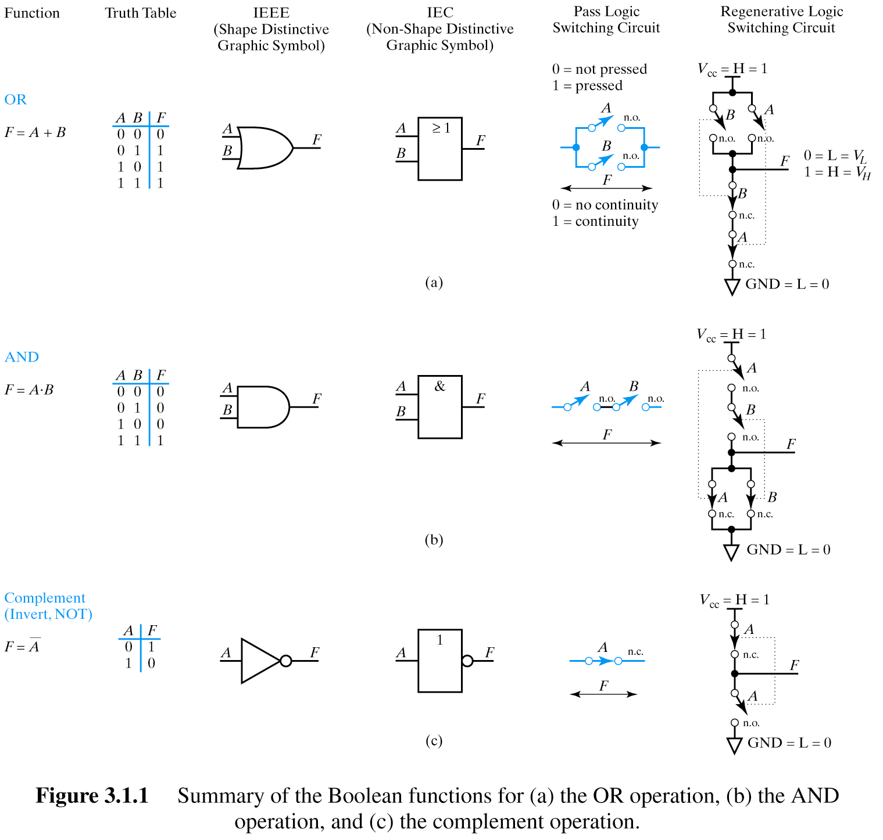
Logic Levels
Input A
5V
V_{IH} = 3.5V
V_{IL} = 1.5V
0V
Output F
5V
V_{OH} = 4.44V
V_{OL} = 0.5V
0V

Slide 22
Noise Margin
Ensures correct behavior despite typical conditions
Vcc = 5.0V
V_{OH} = 4.44V
High
V_{IH} = 3.5V
Undefined
Noise Margin_{high} = V_{OH} - V_{IH}
Noise Margin_{low} = V_{IL} - V_{OL}
V_{IL} = 1.5V
Low
V_{OL} = 0.5V
0.0V
Aside from ensuring correct operation within a logic family, why else might we care about Vih, Vil, Voh, Vol?
Interfacing between logic families!

Slide 23
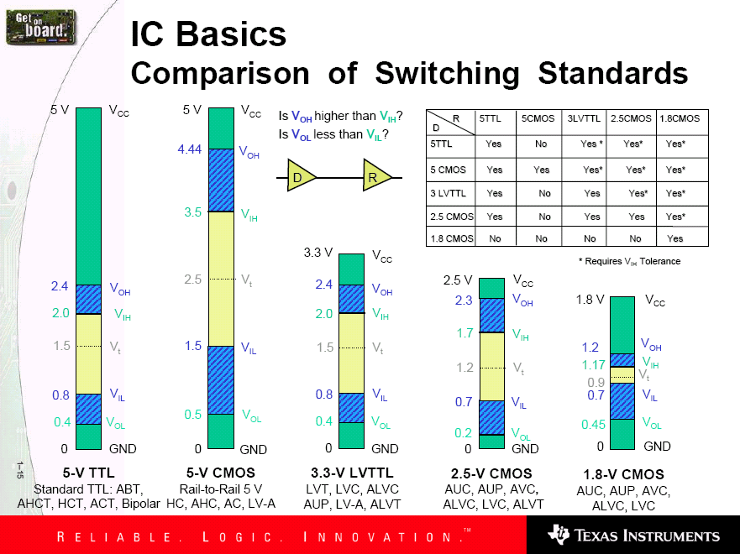
Family Logic Level Comparison
Noise Margins for various families

Slide 24
Propagation Delay

Slide 25
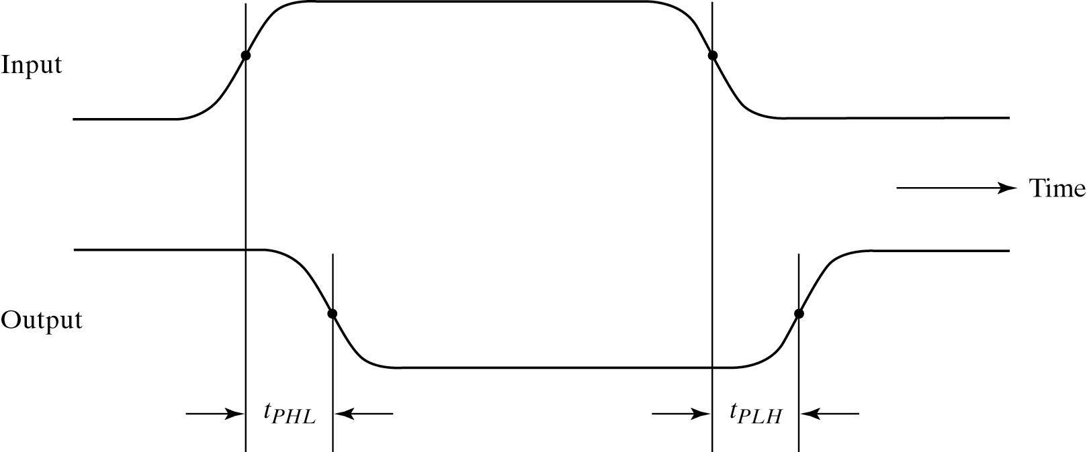
Propagation Delay (T_{pd}, T_{plh}, T_{phl})
Outputs don’t instantaneously reflect input changes
Propagation delay is a measure of this time
Delay from H to L can be different than from L to H
50%
50%

Slide 26
Rise and Fall Time

Slide 27
Rise and Fall Time (T_{r}, T_{f})
Takes time for signal to reach its output voltage
Will be affected by capacitance, fan-out
Also known as slew rate
Typically measured from 10%/90% of V_{OL}/V_{OH} swing
90%
V_{OH}
10%
V_{OL}
t_{r}
t_{f}

Slide 28
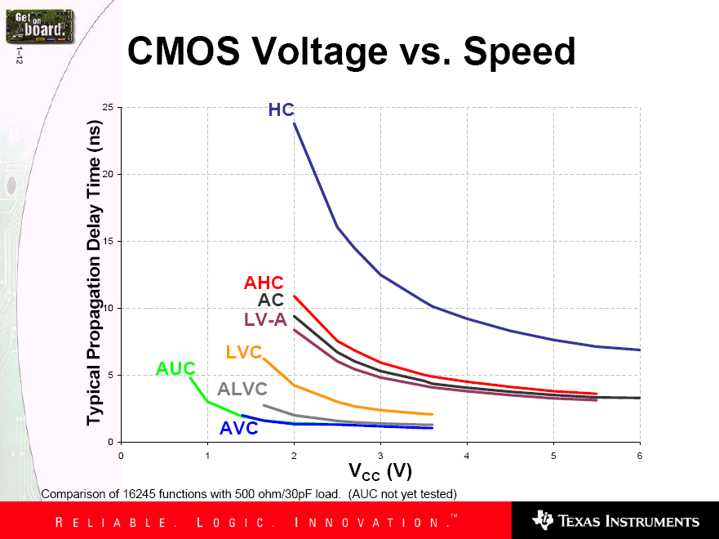
CMOS Voltage vs. Speed
How voltage affects speed?
Voltage grows and speed grows

Slide 29
Fan-Out

Slide 30
Current and Fan-Out
I_{IH}, I_{IL}, I_{OH}, I_{OL}
  I_{IH} Maximum current that flows into the input in H state
  I_{IL} Maximum current that flows into the input in L state
  I_{OH} Maximum current that output can source in H state
  while maintaining output voltage of at least V_{OH}
  I_{OL} Maximum current that output can sink in L state
  while maintaining output voltage of no more than V_{OL}

Slide 31
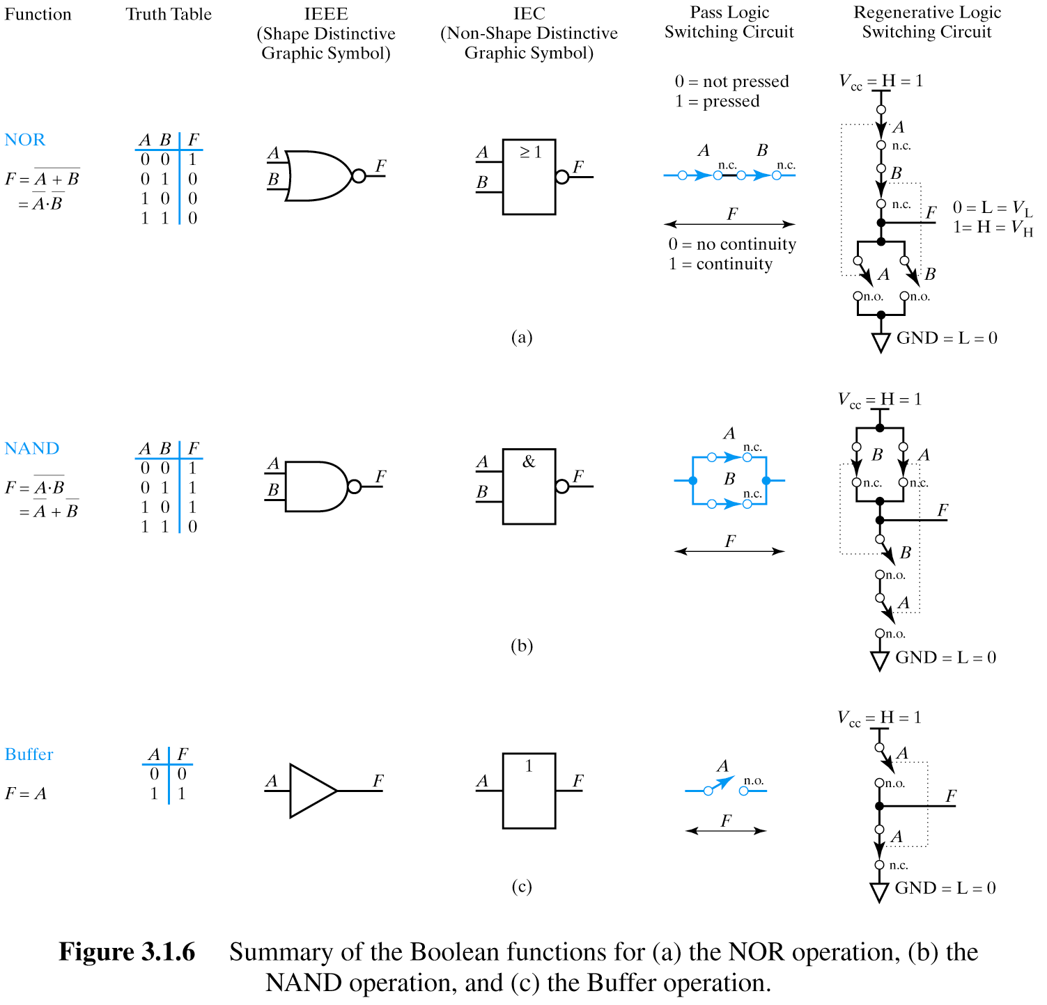
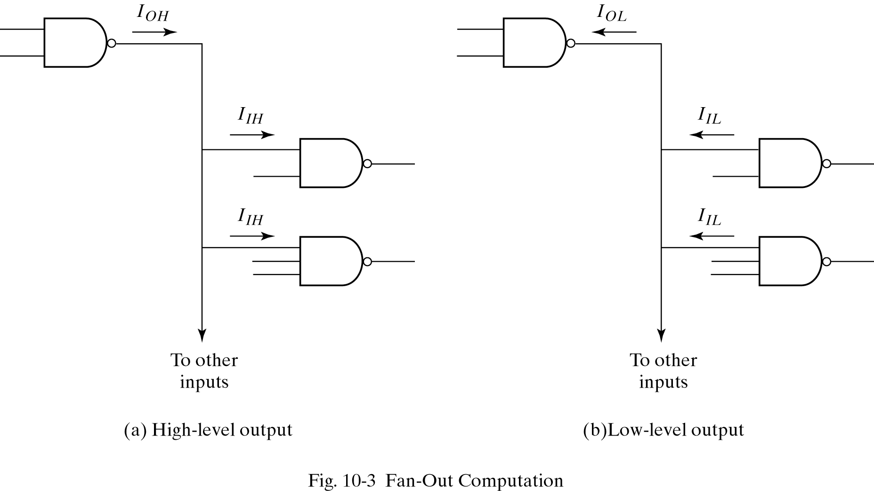
Fan-Out
Sourcing current
I_{OH} = Σ (I_{IH})
I_{OH} Maximum current that output can source in H state while maintaining output voltage of at least V_{OH}
I_{IH} Maximum current that flows into the input in H state

Slide 32
Fan-Out
Sinking current
I_{OL} = Σ (I_{IL})
I_{OL} Maximum current that output can sink in L state while maintaining output voltage of no more than V_{O}
I_{IL} Maximum current that flows into the input in L state

Slide 33
Power Dissipation

Slide 34
Power Dissipation
Power “dissipation” and “consumption”
Static (“quiescent”) power dissipation
  When device outputs not changing
  Very low for CMOS
Dynamic power dissipation

Slide 35
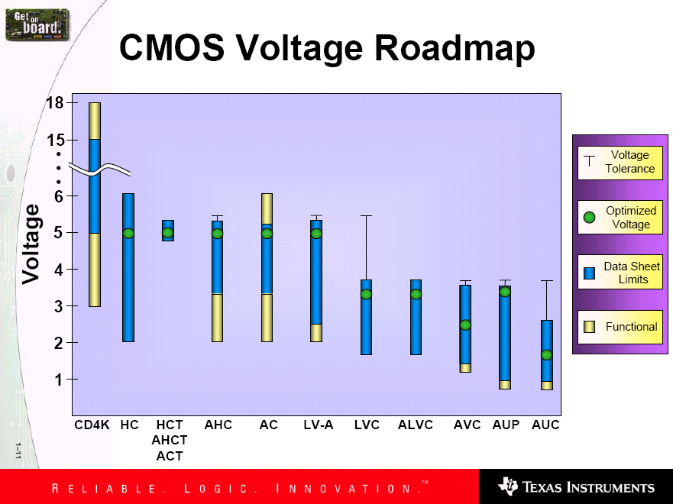
CMOS Voltage Roadmap

Slide 36
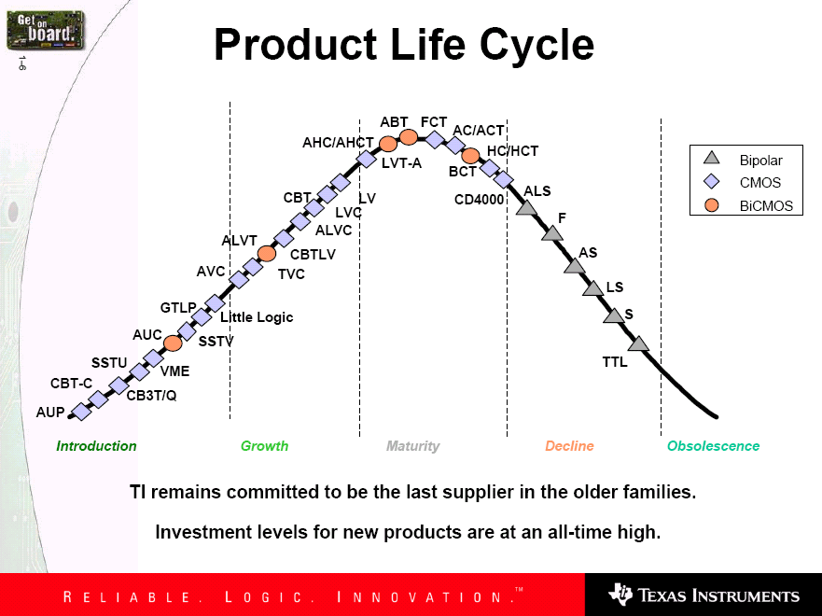
Product Life Cycle

Slide 37
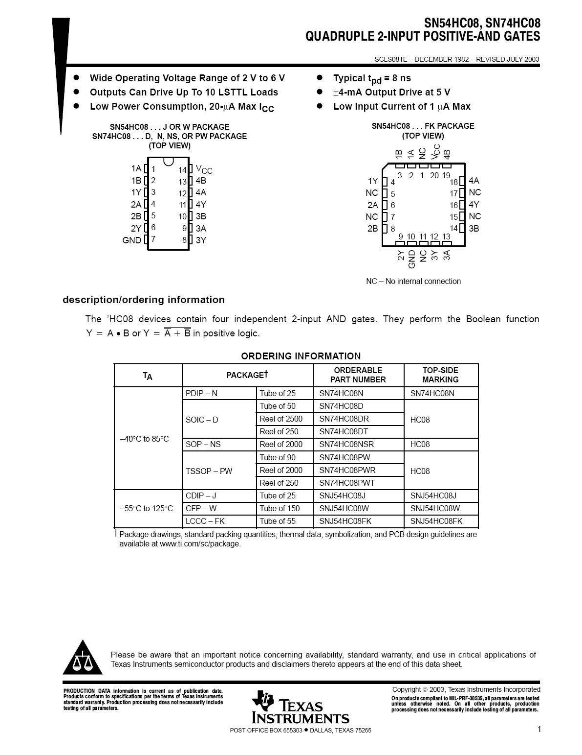
Sample Data Sheet (Part 1)
Brief device description
Package options and pinouts
Part number: SN54/74<family><function>
SN54 – military; SN74 commercial
HC – high speed CMOS family
08 Quad 2-input positive (logic) AND gates
Main features/benefits of device (“features bullets”)
Description

Slide 38
Sample Data Sheet (Part 2)
Note different environmental conditions specified for 74/54
Package style
Availability and corresponding orderable part number

Slide 39
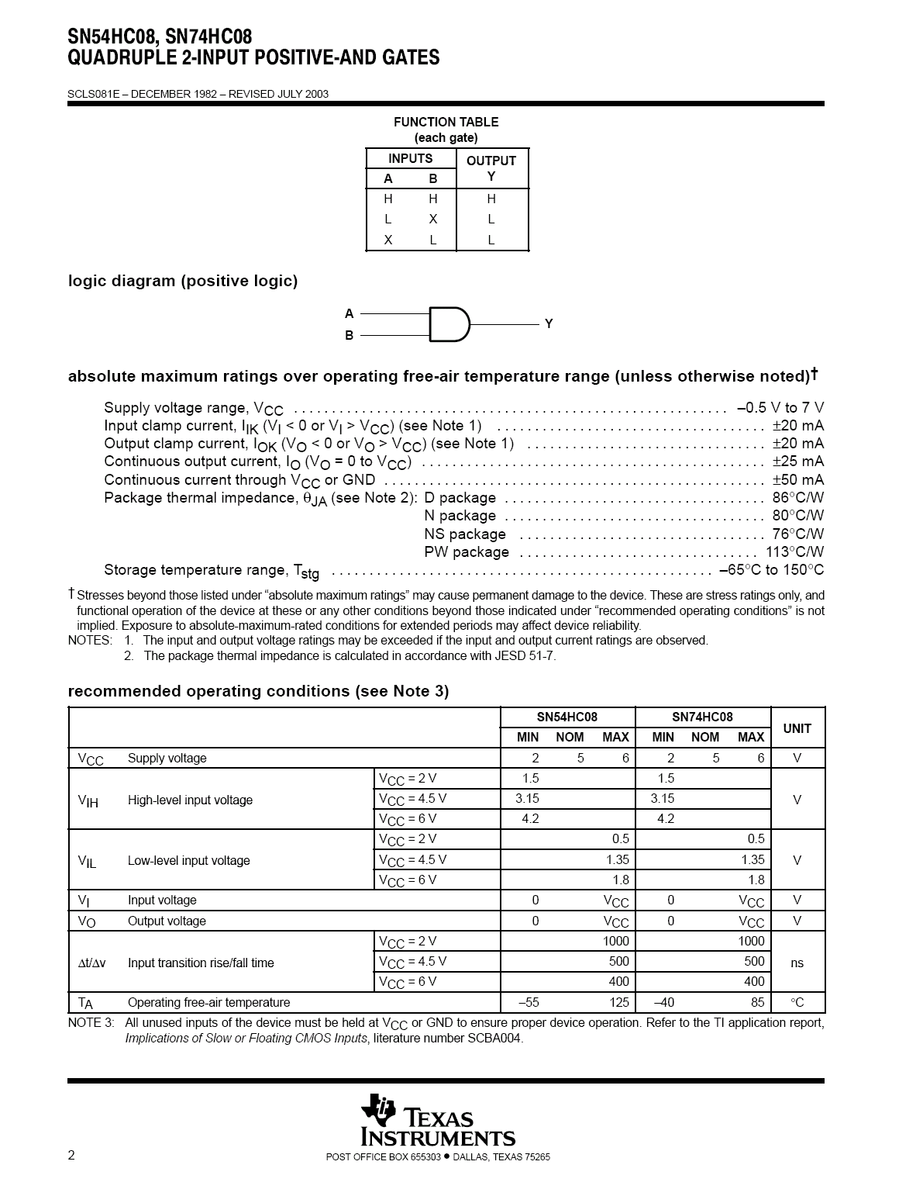
Sample Data Sheet (Part 3)
Not Operating Conditions!

Slide 40
Maximum
Nominal
Minimum
~70%

Slide 41
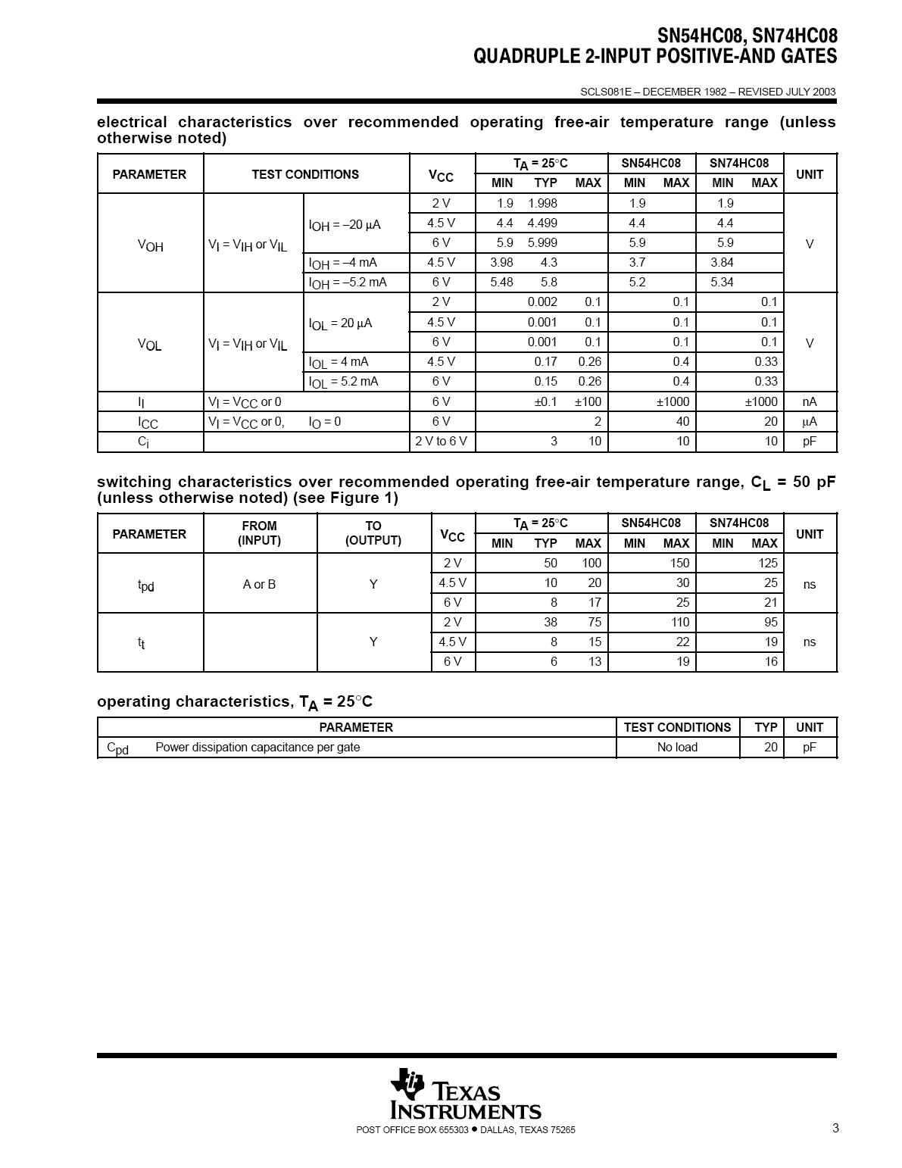
Sample Data Sheet (Part 5)
Sometimes called “dc section”
Voh conditions:
Ioh = -20uA represents fairly normal conditions of sourcing current and results in a Voh of approximately Vcc-0.10
Ioh - -5.2mA represents high loading (TTL?) and we see a subsequent drop in the guaranteed Voh value
Similarly for Vol
Iol of 20uA results in max Vol of 0.1V (Gnd + 0.1)
Iol of 5.2mA results in max Vol of 0.33V
Notes:
Voh conditions:
Ioh = -20uA represents fairly normal conditions of sourcing current and results in a Voh of approximately Vcc-0.10
Ioh - -5.2mA represents high loading (TTL?) and we see a subsequent drop in the guaranteed Voh value
Similarly for Vol
Iol of 20uA results in max Vol of 0.1V (Gnd + 0.1)
Iol of 5.2mA results in max Vol of 0.33V

Slide 42
Sometimes called “ac section”
Include “From (Input) and To (Output)” because in more complex devices there will be multiple paths and multiple outputs.
In this device single Tpd (worst case of Tplh and Tphl)
Similary Tt instead of Tf and Tr

Slide 43
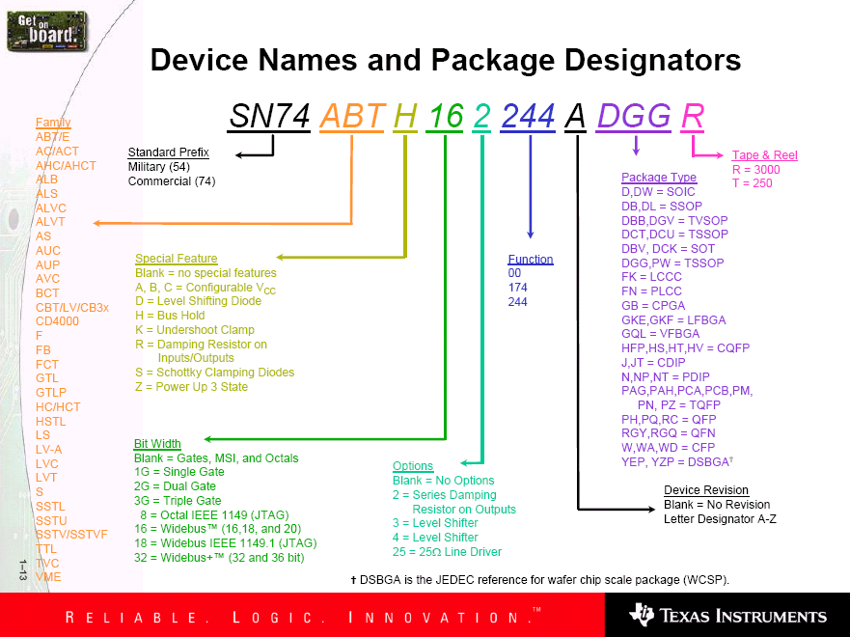
Device Name and Package Designators

Slide 44
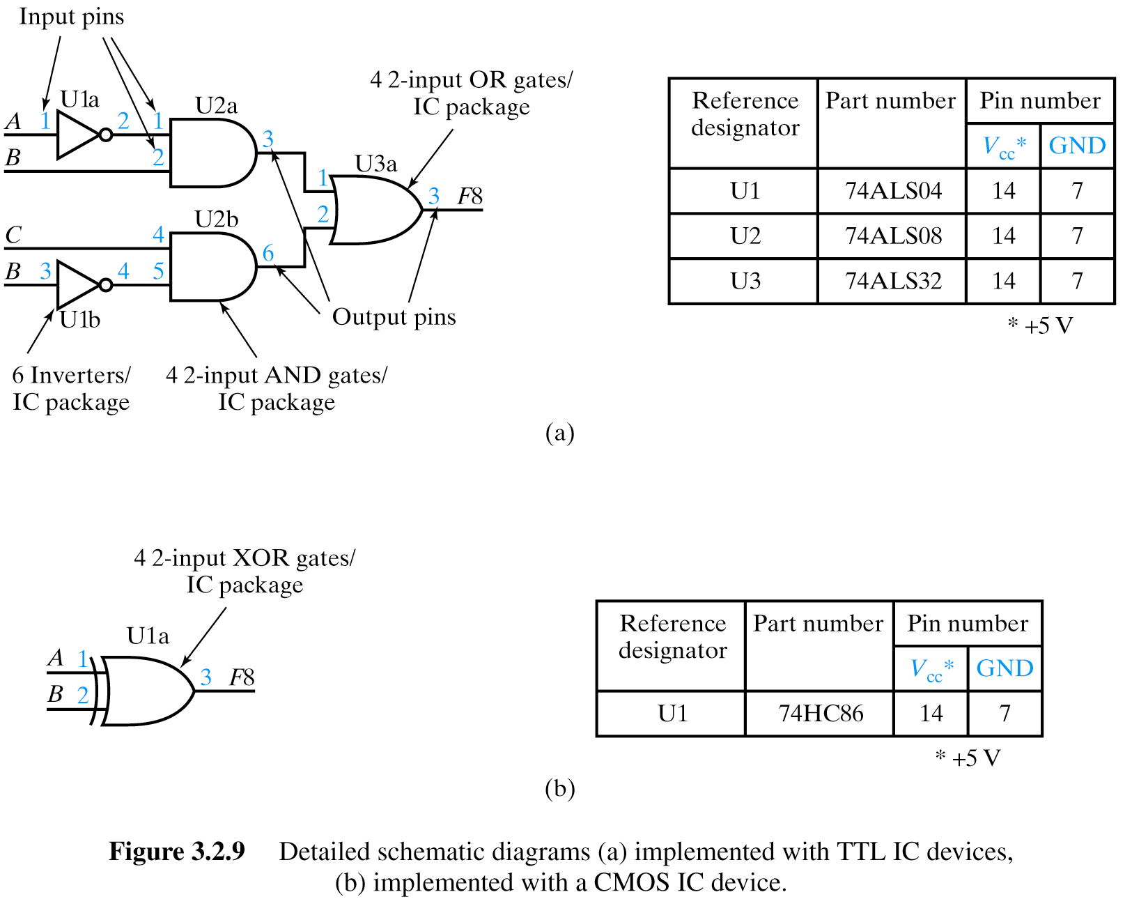
Detailed Schematic Using ICs

Slide 45
Sources
Prof. Mark G. Faust

